Slide 1

Binary Heaps
BY: Arturo Garibay

Slide 2
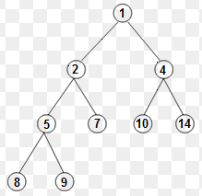
Why is it called a “Binary” Heap?
Parent
Parent
Parent
Due to each parent only allowed a MAX of 2 children.
Child nodes have ONE parent only
Child
Child
Child
Child
Child
Child
Parent
Child
Child

Slide 3
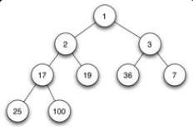
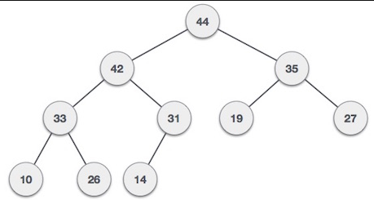
There are 2 types of Heaps
MinHeap
Smallest value is the root
MaxHeap
Largest value is the root

Slide 4
What’s used in Binary Heaps
Arrays
Heap Sort
to sort the values in an array
Priority Queues:
insert(), delete(), extractMin(), extractMax(), decreaseKey(),getMin(), getMax()

Slide 5
What each Priority Queue does
insert()
used to place a value in the array
delete()
Used to remove a value from an array
decreaseKey()
decreases the value of a key at index I to a new value
getMin()
used to get lowest/smallest value
getMax()
used to get largest value in the array
extractMin()
Removes lowest/smallest value
extractMax()
Removes largest value

Slide 6
Deletion consists of:
extractMin()
decreaseKey()
MinHeapify()
Used to Heapify a subtree
(Show example on board)

Slide 7
Where would I use Binary Heaps?
In the real world, it would be uncommon to use binary heaps, but some would use them on:
Dijkstra’s algorithm (shortest path)
Huffman encoding(data compression)
Prim’s algorithm(min span tree)

Slide 8
Credits:
https://www.geeksforgeeks.org/binary-heap/

